Slide 1
One Mind for Research Summit
“You Are Now Where Cancer Was”
(so what can the future learn from the past?)

Slide 2
The State of Cancer Then
Enormous toll in loss of life and human suffering
Escalating economic burden
Extensive societal and political concern
Emerging technologies and tools
Evolving therapeutic options
Exciting growth in scientific research
The State of Neuro-disorders Now

Slide 3
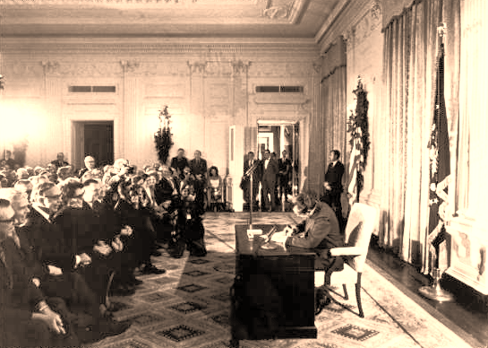
The Dream of Yesterday National Cancer Act of 1971
President Richard Nixon signs National Cancer Act on December 23, 1971
“Make the Conquest of Cancer a National Crusade”

Slide 4
The Hope of Today (legislation)
Cures for the 21st Century
House Energy and Commerce Committee
Innovation for a Healthier America
Senate Health, Education, Labor and Pensions Committee
“Precision Medicine”
President Obama Administration
“Make the Conquest of Brain Disorders a National Crusade”

Slide 5
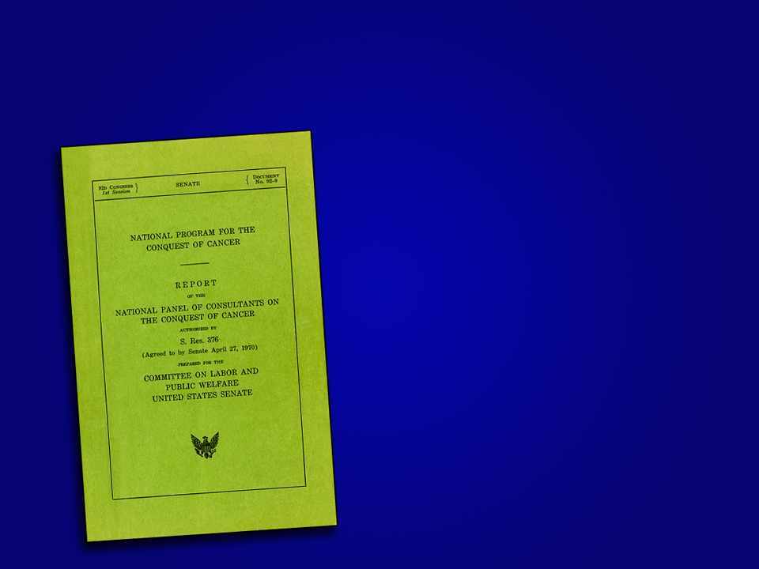
National Program for the Conquest of Cancer
“However, the findings of molecular oncology are likely to be applicable to many types of cancer and to be radical in nature.
They will also have an impact far beyond the problem of cancer itself.”

Slide 6
Strategic Inflection
Progress
Biotechnology can change the world
Cancer as the focus
Momentum
Lost
1971
NOW
Future
After Andrew Grove “Only the Paranoid Survive”.
Notes:
2004
Strategic inflection point

Slide 7
Strategic Inflections
Then
Understanding Life/Cancer
Now
Understanding the Brain
Then has lead to Now

Slide 8
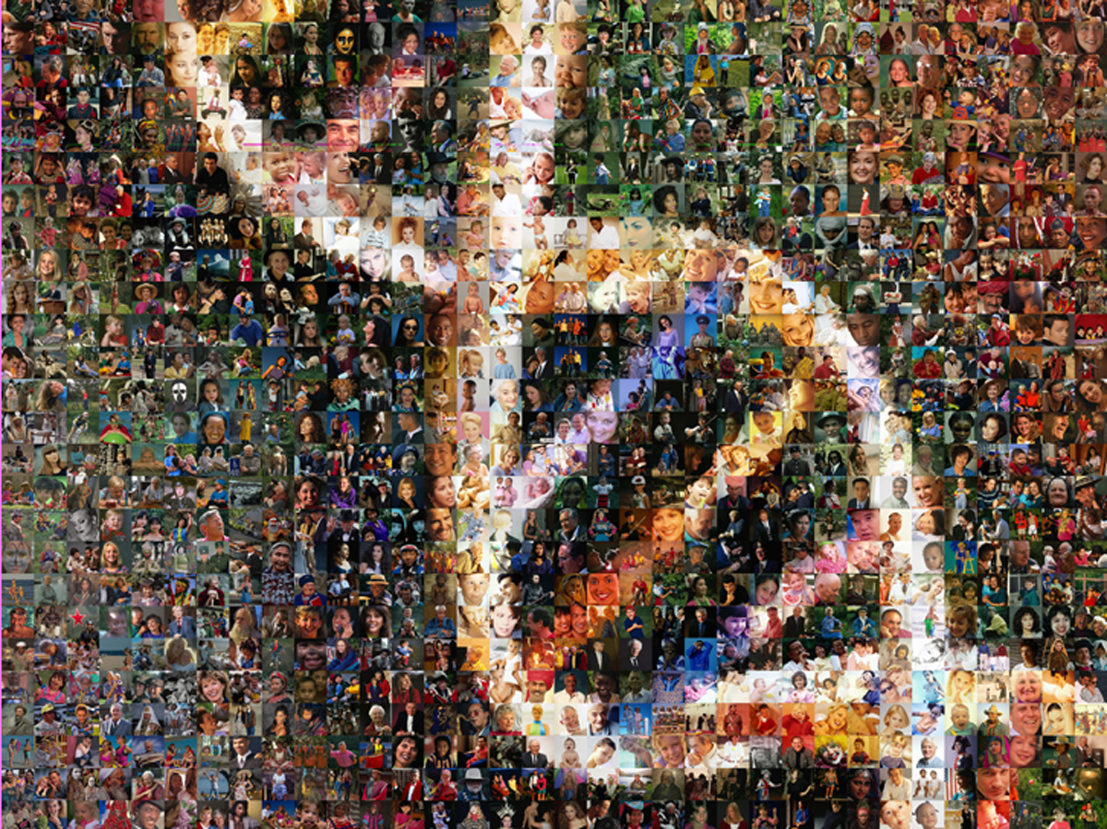
The “-omics”
Revolution
The “-omics”
Evolutionary
Revolution
30 years of research
to reach a
strategic inflection in our nation’s effort to conquer cancer.
Image courtesy of Nature. Feb. 15, 2001
Notes:
I have been fooling around with this for a some time. Here’s my sequence of events:
First I moved the whole helix picture into Photoshop. Cut out the helix and saved it with transparent background. But, I could not figure out how to make the file a reasonable size, make the edges not have little white dots and preserve transparency.
In Powerpoint, I put a blue gradient fill on top of the people helix so you can read the letters. Next I imported my cut out helix into this slide and put it on top of the gradient, exactly registered with the helix beneath the blue gradient fill. (it is not here now - because the file is too big).
This gave me a nice sharp helix with clean whites and colors AND yellow type that the audience could read. Can you do this or do something that gives the result I want?

Slide 9
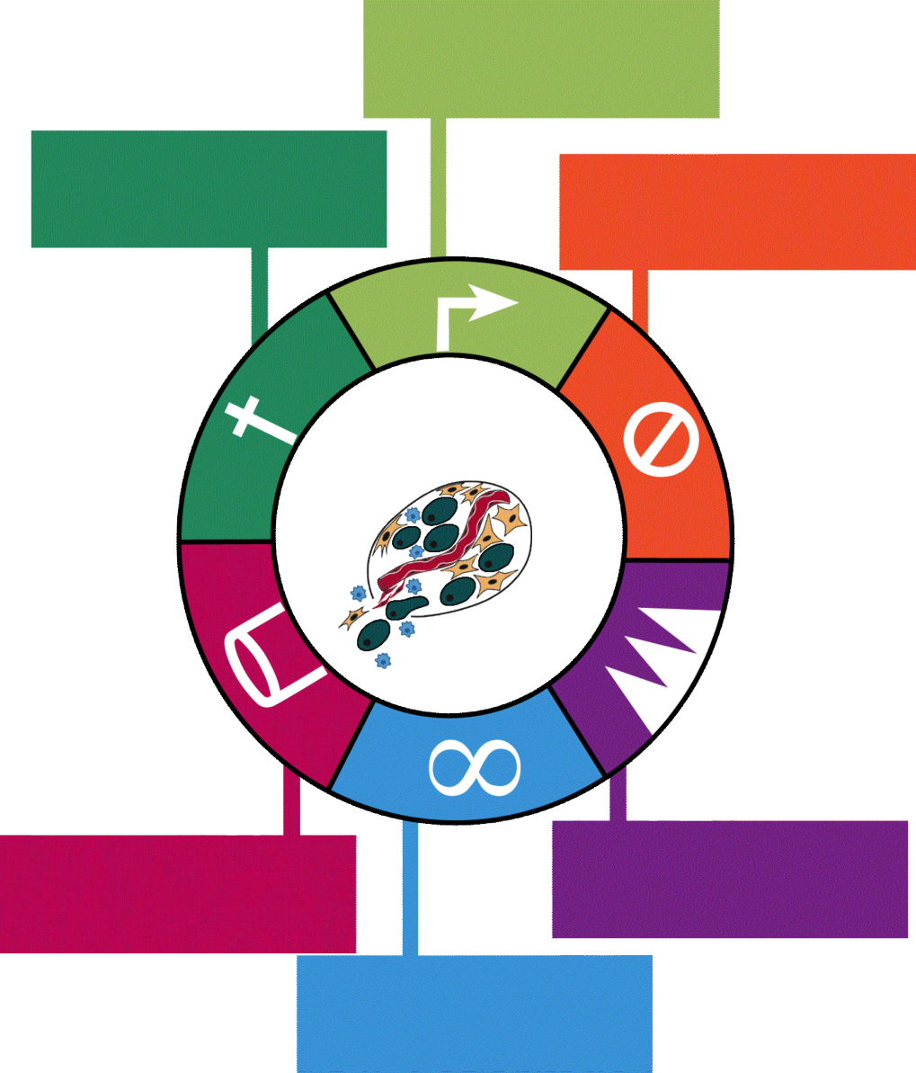
Molecular Mechanisms of Cancer
Self-Sufficiency in Growth Signals
Evading Apoptosis
Insensitivity to
Anti-Growth Signals
Sustained
Angiogenesis
Tissue Invasion
and Metastasis
Limitless Replicative
Potential
After Hanahan & Weinberg,
Cell 100:57 (2000)

Slide 10
Molecular Mechanisms
of Neuro-disorders
Trauma/Inflammation?
Senescence
Apoptosis??
Energy and Metabolite Imbalance???
Cytokine disruption???
??????
????????????
After Hanahan & Weinberg,
Cell 100:57 (2000)

Slide 11
Understanding Mechanisms Not Manifestations of Disease
Then
Changed the paradigm of Structure/Function Rx
Now
Integration of physical and biochemical Interventions
Then has lead to Now

Slide 12
KEY: Rational Integrated Therapy
Cancer and Neurodisordes are PROCESSES not simply events
Complex processes require complex interventions
Complex Interventions must be rational, strategic and integrated
Such interventions are diverse in their nature but common in their design
Such interventions are interoperable and not simply combined

Slide 13
Intervention in the Cancer Process Prevent Detect Eliminate Modulate
2005
Death due to Cancer
Metastatic
Progression
2015
Malignant Transformation
Susceptibility
Pre-Cancerous Changes
Birth
Life Span
Natural
Death
Notes:
The defined processes include factors that increase susceptibility to cancer, mechanisms that convert pre-cancerous cells to a malignant stage, and further progression to metastatic disease. Understanding these processes provides multiple opportunities throughout the disease process for intervention.
[Arrows will zoom down]

Slide 14
The Process of Progress
Discovery
Development
Delivery
Discovery of molecular mechanisms
Development of targeted interventions
Delivery to selected patients and tumors with real time modulation

Slide 15
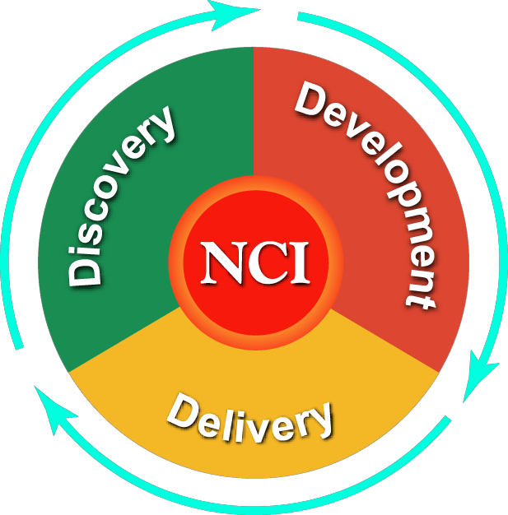
Integration and Collaboration
MD Anderson
Duke / MSK
Georgetown
Cal Tech Jet Propulsion Lab
Northwestern
Alpha Gamma
UC Davis
Virginia Tech
City of Hope
U of Iowa
First Genetic Trust
Oregon Health & Science U
U of Colorado
Northwestern
U of Nebraska
Washington U
Case Western Reserve
Jackson Laboratory
Scenpro
St. Jude’s Children’s
Research Hospital
U of Vermont
NYU / UC Irvine
UCSF / CTIS
Mayo / U of Iowa
NCI DCTD
Terrapin Systems
Emmes Corp
Indiana CARRA
UCSF
Dartmouth / SAIC
Vanderbilt
Meyer L. Prentis
NCI DCCPS
U Pittsburg
NCI CCR
U of Minnesota
Burnham Institute
Cold Spring Harbor
NCI
U Penn / Ardais
Fox Chase / IMS
Fred Hutchinson
SAIC
NCI CTEP
U of Hawaii
NCI Center
for Strategic Dissemination
Roswell Park
Albert Einstein
City of Hope
Drexel / NCI Alabama / VCU
U of Pittsburg
GE Global Research
Dept of Veterans Affairs
Lawrence Berkley National Lab
Johns Hopkins Constella Health Systems
Wake Forest
Data Works Development
NCI Center for Bioinformatics
Vanderbilt / USC
MIT / NCI DCP
Thomas Jefferson U
Argonne National Lab / Columbia
Lawrence Berkley
U of Wisconsin
NCI OC
Ohio State
Tulane U SOM
9Star Research
U of Nebraska
NCI DCEG
IBM
Wistar Institute
U of Michigan
U of South Florida
U Arizona

Slide 16
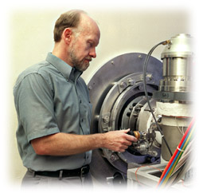
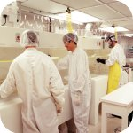
The Tools from Then to Now
Bioinformatics
Biorepositories
Molecular Imaging
Nanotechnology
Genomics
Biomarkers- Proteomics
Stem cell biology

Slide 17
CHANGE
Then
The Game was Golf!!
Now
The Game is Basketball!!
Culture versus Skills/Tools

Slide 18
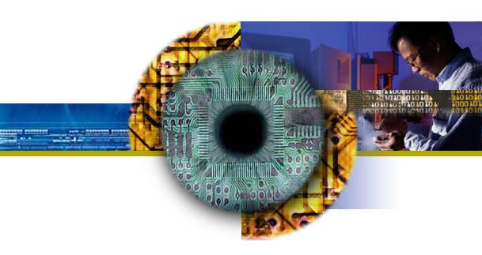
Concept: A National Network to Leverage Existing and Emerging Advanced Technology Development Resources
National Advanced Technology Initiative for Cancer (NATIc)
Virtual Networks to Catalyze the Discovery and Development of 21st Century Cancer and Biomedical Technologies and Targeted Medicines…
…and deliver them to all in need to accelerate the conquest of cancer and other devastating diseases.

Slide 19
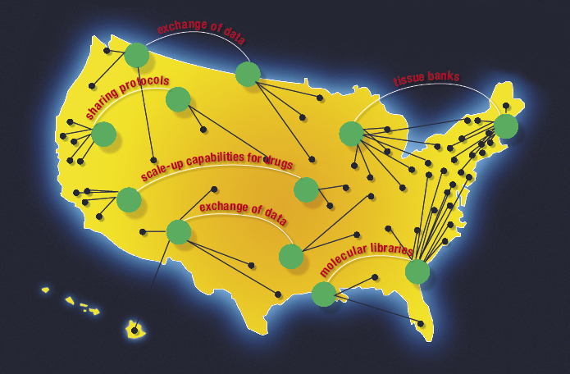
As Envisioned: the National Advanced Technology Initiative for Cancer - A Nationwide Virtual “Network of Networks”

Slide 20
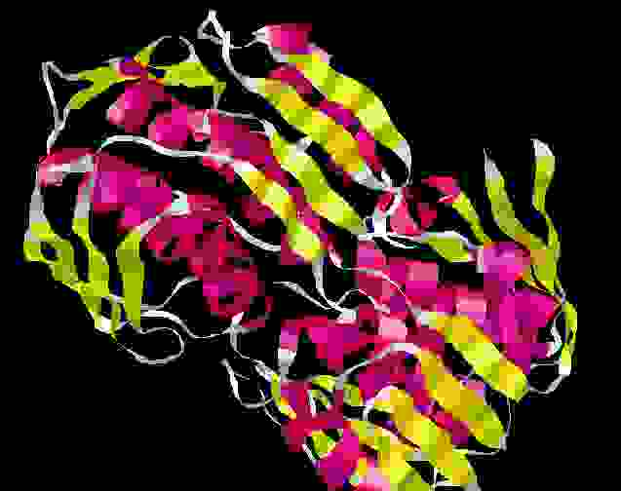
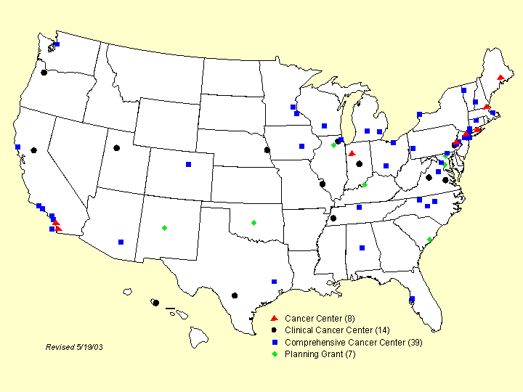
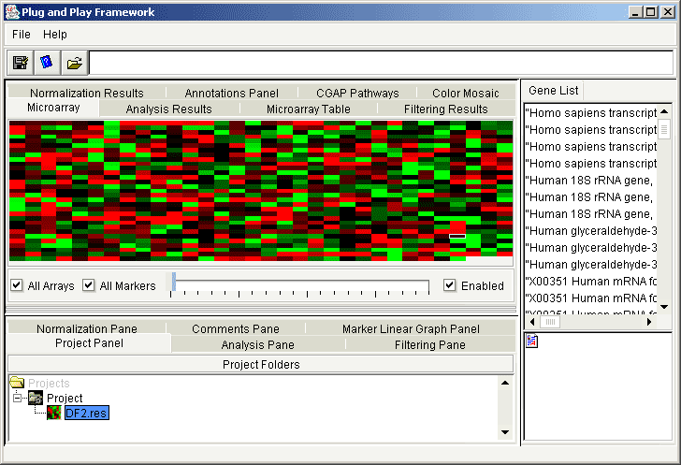
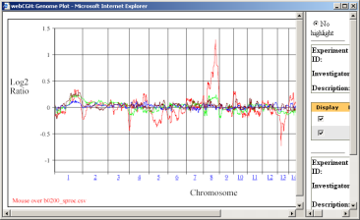
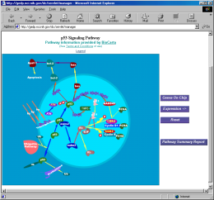
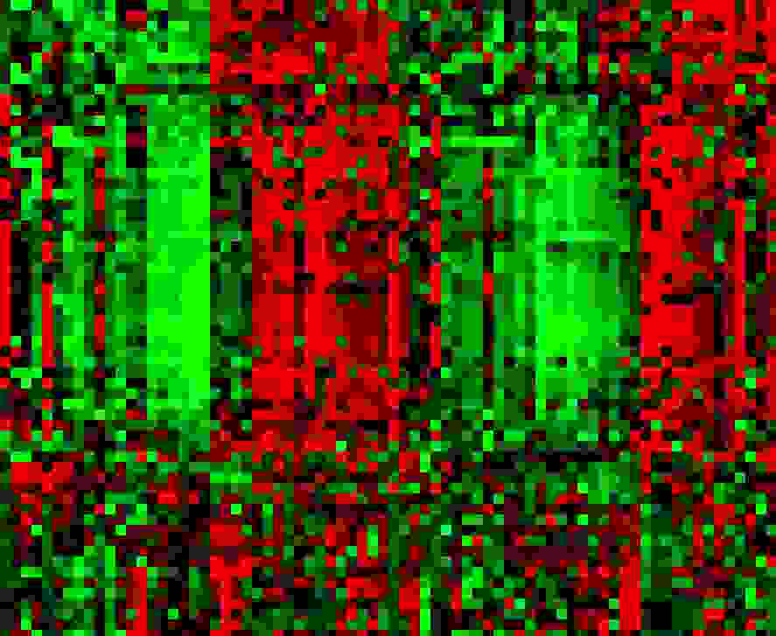
Interoperable Bioinformatics Platform (caBIG) – Infrastructure for Standards and Data Exchange

Slide 21
The Cancer Bioinformatics Grid (CaBIG)
A unifying bioinformatics system
Empowering systems biology, clinical trials, electronic medical records, etc.
Open source – “plug and play”
Rapidly developing connectivity – common language, common software and systems
Pilots underway in cancer centers
Standards based– (e.g., clinical trials; bio specimens; genomic and clinical data )
Public private partnerships evolving

Slide 22
From Then to Now
The World has changed!
We know more
The Genetic ,Molecular and Cellular basis of all diseases

Slide 23
In 2015…
Taxonomy of cancer is based on molecular processes
Molecular: based on a genetic signature, signal transduction pathway, or network aberration
No longer based on anatomy, e.g., breast or prostate
No longer based on histology, e.g., sarcoma, adenocarcinoma
Ligand
2
1
K
Grb2
Ses
K
Sch
Shc
Grb2
P13K
Sos
Ras
PTEN
Akt
Raf
GSK-3
MEK1/2
mTOR
FKHR
Bad
p27
MAPK
Cyclin D1
cell cycle
progression
survival
proliferation

Slide 24
From Then to Now
The World has changed!
We know more,
we can understand more
Quality improves; Costs decrease

Slide 25
Quality Improvement Model Adapted to Individualized Oncology Now called Precision Medicine
Waste
Empiric Therapy
Targeted Therapy
Quality
Waste due to
Insufficient Rx
Waste due to
Excessive Rx
Insufficient
Intervention
Excessive
Intervention
Optimal
Intervention
Notes:
October 2004

Slide 26
From Then to Now
The World has changed!
We know more,
we can understand more,
we will do more!
Progress will be exponential as the future builds on the past

Slide 27
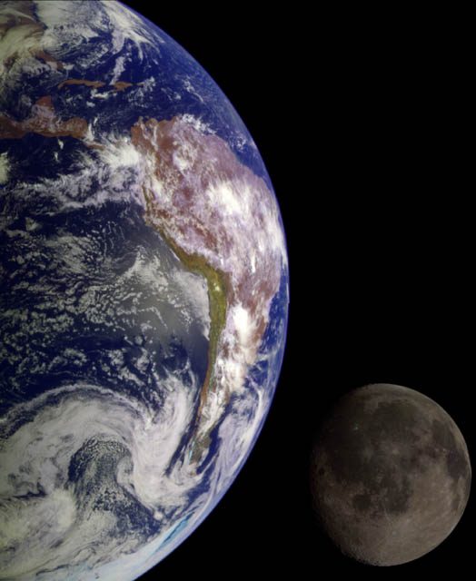
January 1958: U.S. launches first satellite
May 1961: President Kennedy announces his vision of ”landing a man on the moon and returning him safely to earth” by the end of the decade
3.33 years
0.75 years
February 1962: John Glenn orbits the Earth
7.42 years
July 1969: First man walks on the moon

